Slide 1
Real-Time Age & Gender Detection using Jetson Nano
-Tejaswini Veeramachaneni
-Sruthi Velpula

Slide 2
Problem Statement
Airport Security Monitoring Challenges:
Airports handle high passenger traffic, making manual monitoring difficult
Lack of real-time automated age and gender analysis
Manual methods are time-consuming and prone to errors
Cloud-based solutions introduce latency and privacy concerns
Need for a fast, edge-based AI system for airport security

Slide 3
Project Objective:
Design a real-time system to detect age and gender of passengers
Implement an edge-based AI solution using Jetson Nano
Reduce latency and privacy risks by avoiding cloud processing
Support airport security and crowd monitoring applications
Demonstrate a practical and scalable computer vision system

Slide 4
System Architecture
Input: USB camera captures live video frames
Face Detection: Haar Cascade detects faces in each frame
Centroid Tracking: assigns a unique ID to each detected face across frames
People Counting: count = number of tracked IDs (unique people)
Preprocessing: convert face ROI to blob (227×227)
Inference Models:
  GenderNet → Male/Female
  AgeNet → age range bucket
Output: show bounding box + ID + age + gender + people count on live video

Slide 5
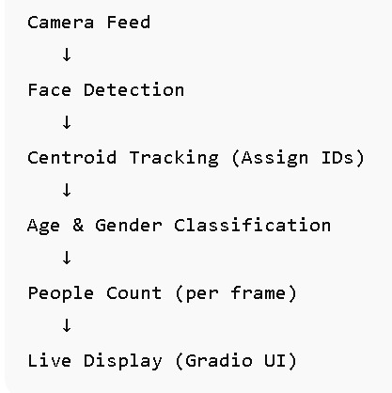
Workflow
Capture live video frames using a USB camera
Detect faces in each frame using Haar Cascade classifier
Apply Centroid Tracking algorithm to track faces across frames
Assign a unique ID to each detected person and count total people
Extract face region of interest (ROI) for each tracked person
Preprocess face images to the required input size (227 × 227)
Perform age and gender prediction using deep learning models
Display bounding box, ID, age, gender, and people count on live video

Slide 6
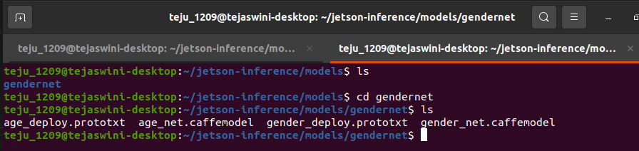
Models Used
AgeNet
  Deep learning model for predicting age range
  Outputs age in predefined age group buckets
  Accuracy : 65- 70%
GenderNet
  Deep learning model for gender classification
  Outputs Male or Female
  Accuracy : 85%
Both models are Caffe-based pre-trained models
Models loaded and executed using OpenCV DNN module
Optimized for real-time inference on Jetson Nano

Slide 7
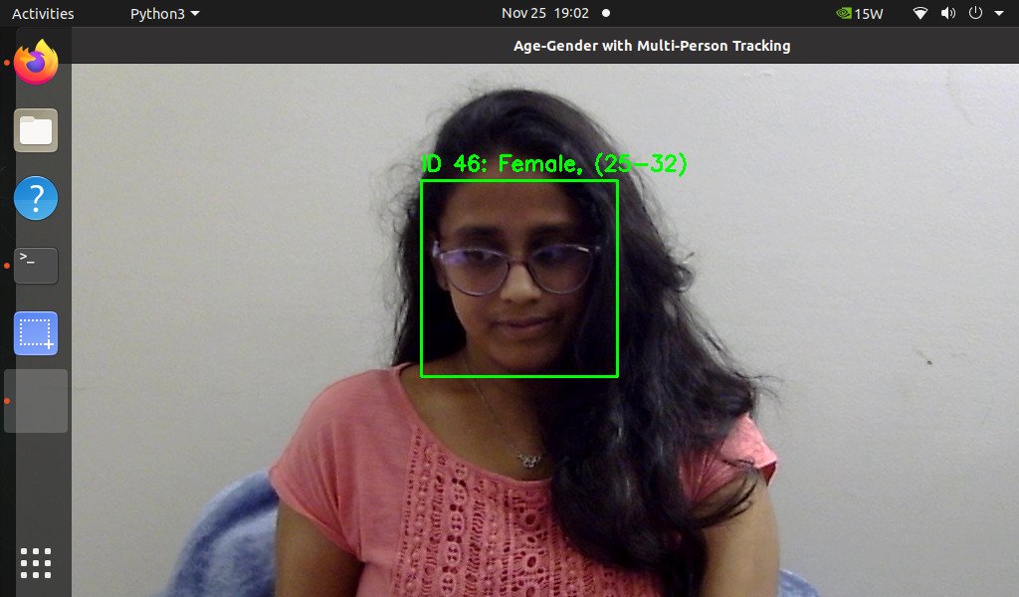
Centroid Tracking Algorithm
Centroid tracking is a object tracking technique used to detected faces across video frames.
Lightweight, fast, and suitable for real-time applications .
The center point (centroid) of the bounding box is calculated for each detected faces.
If no matching centroid is found, the algorithm assigns a new ID to that face.
Prevents counting the same person multiple times by remembering the past faces with ID.

Slide 8
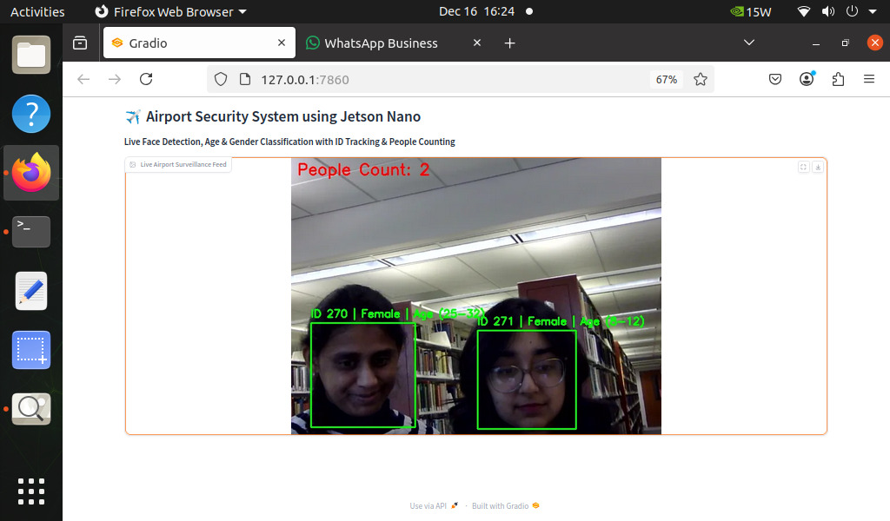
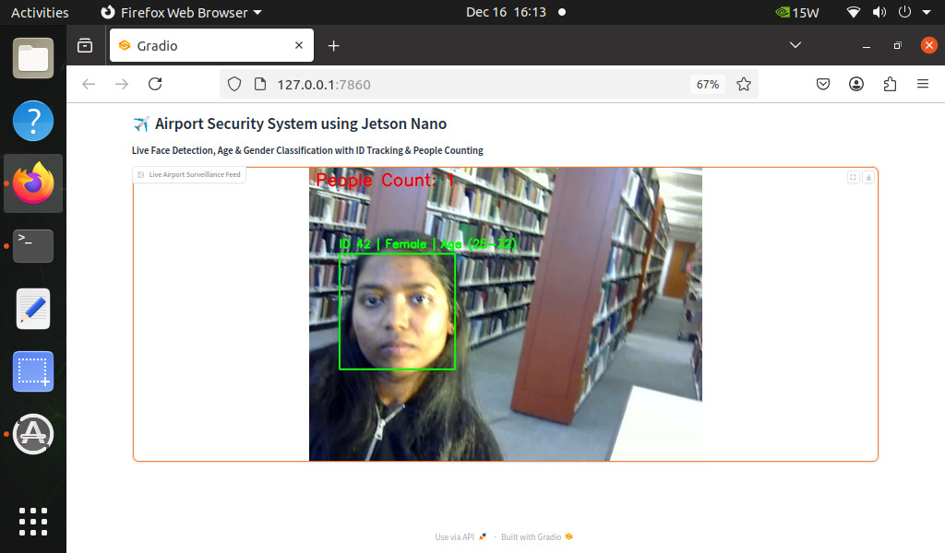
Result

Slide 9


